Slide 1
Tom Green in a Nutshell
EN.645.667 Introduction

Slide 2
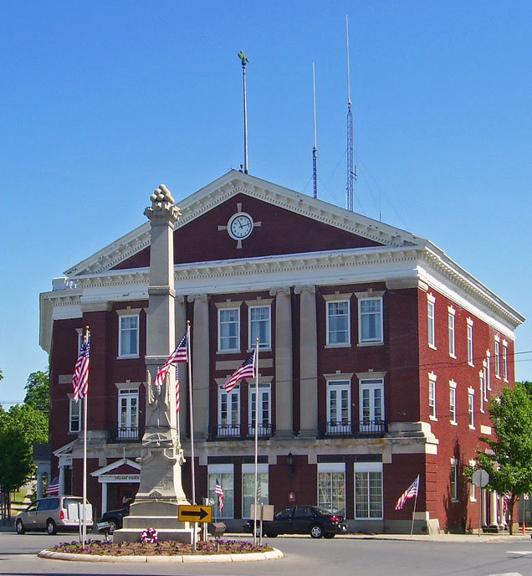
Summary
The early years - Grew up in small town – Walden NY
Josephine Louise Public Library

Slide 3
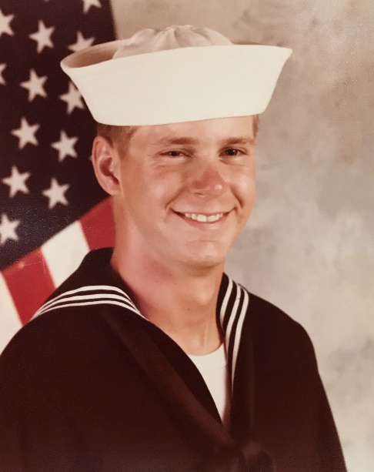
Summary
The early years - Grew up in small town – Walden NY
Entered Navy after high school - 20 years
~ 14 years as a mechanical operator on nuclear propulsion plants
Switched to electronics – mainly communications gear

Slide 4
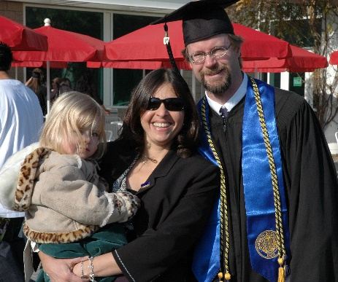
Summary
The early years - Grew up in small town – Walden NY
Entered Navy after high school - 20 years
~ 14 years as a mechanical operator on nuclear propulsion plants
Switched to electronics – mainly communications gear
Education – BS Mechanical Eng from UC Davis

Slide 5
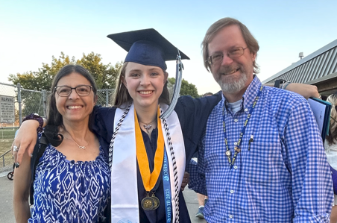
Summary
The early years - Grew up in small town – Walden NY
Entered Navy after high school - 20 years
~ 14 years as a mechanical operator on nuclear propulsion plants
Switched to electronics – mainly communications gear
Education – BS Mechanical Eng from UC Davis
Nine years at a small wind energy startup, Frontier Wind
Last six years at Northrop Grumman
Latest role 100% SE → JHU MSE

Slide 6
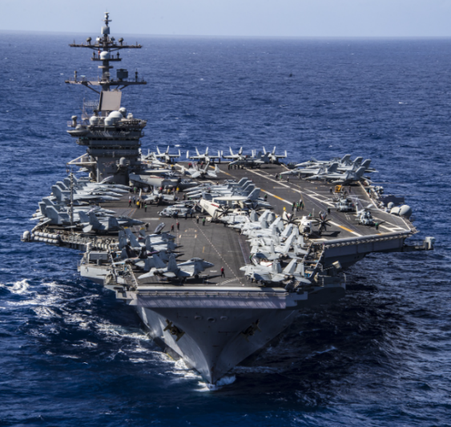
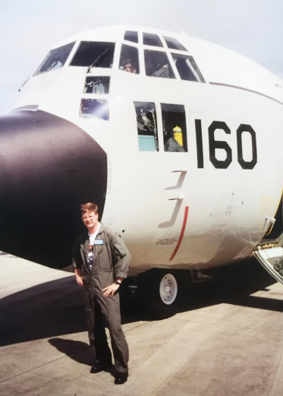
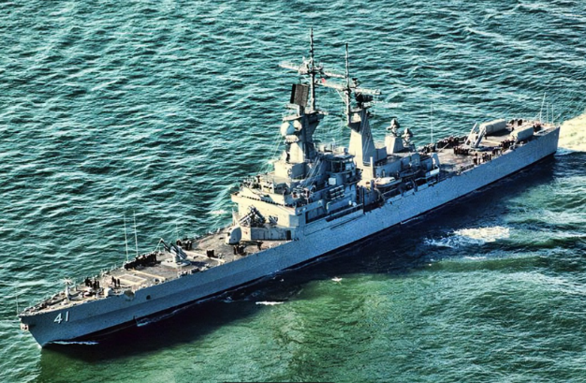
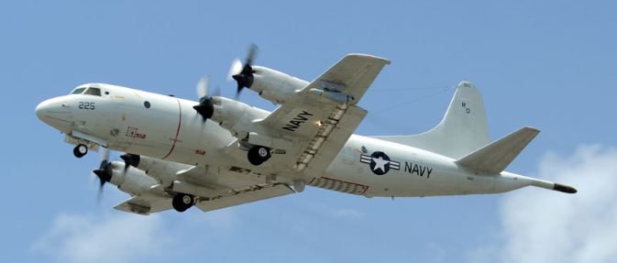
Navy Career
Nuclear Power School & Prototype path
Staff duty at nuclear prototype – upstate NY
USS Carl Vinson (CVN-70)
Advanced Programs Recruiting
USS Arkansas (CGN-41)
USS Nimitz (CVN-68)
Electronics Schools
Mobile Operations Command Center (MOCC) Pt Mugu, CA

Slide 7
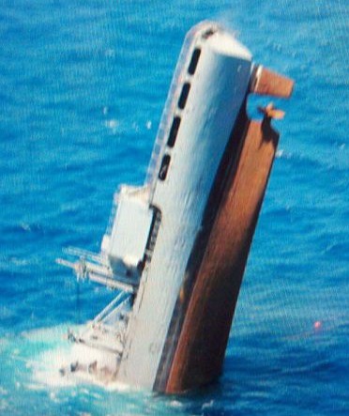
Navy Career
Nuclear Power School & Prototype path
Staff duty at nuclear prototype – upstate NY
USS Carl Vinson (CVN-70)
Advanced Programs Recruiting
USS Arkansas (CGN-41)
USS Nimitz (CVN-68)
Electronics Schools
Mobile Operations Command Center (MOCC) Pt Mugu, CA
USNS Niagara Falls (TAFS-3) – Guam

Slide 8
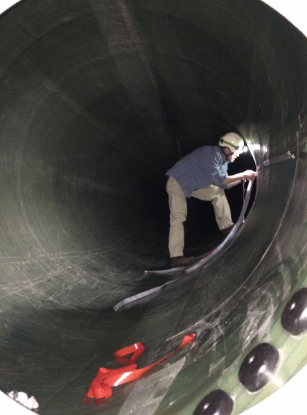
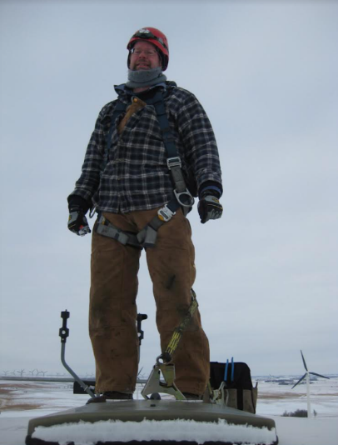
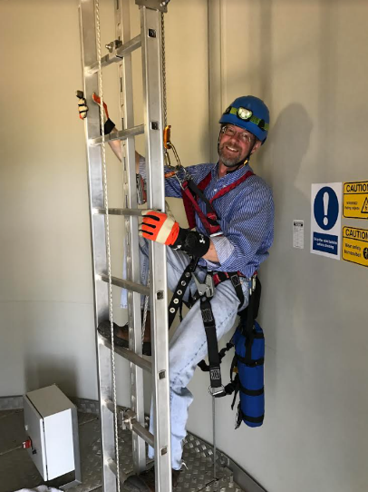
Work Work Work
Frontier Wind – On-Blade Load Control Systems
Mechanical Designer
Moved to test, then embedded control
Concept to deployment – lots of field experience
Northrop Grumman
Embedded control
Moved into integration & test on same small-ish project
New project is huuuge and my role is 100% SE
Started doing a lot of review of SE activities
Made sense to get credit for the study I was already doing, so here I am
Other than budgeting and scheduling in Navy roles and WBS/IMS inputs, no real project management experience

Slide 9
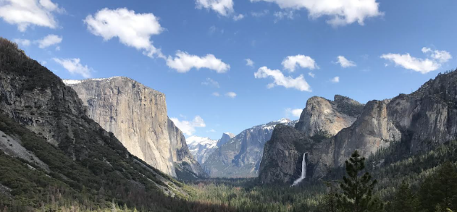
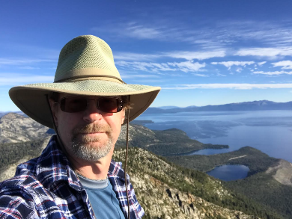
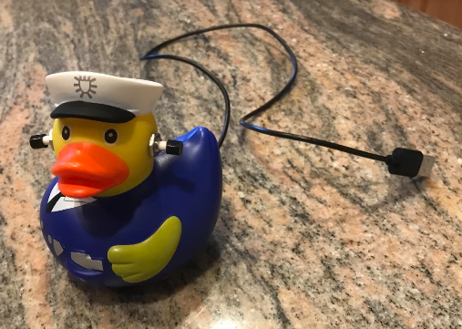
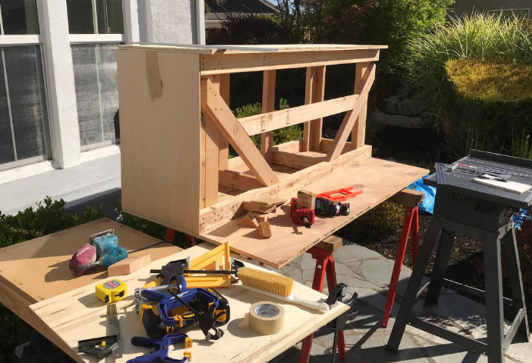
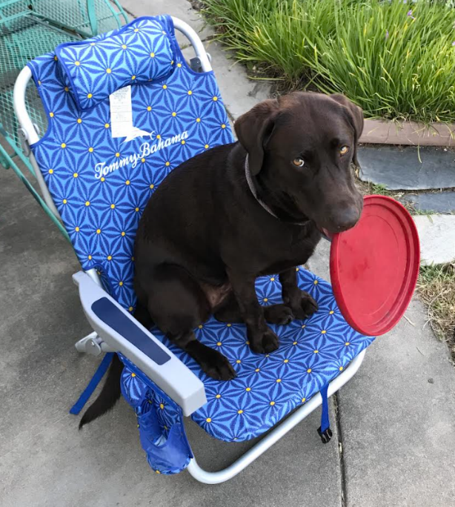
The Fun Stuff – Hobbies
Reading, way too much reading
Hiking
Skiing, Boarding, Snow-shoeing
Set builds for local theater
Random projects
Hanging out w/ the doggo

Slide 10
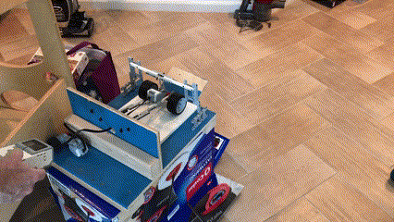
The Fun Stuff – Hobbies
Reading, way too much reading
Hiking
Skiing, Boarding, Snow-shoeing
Set builds for local theater
Random projects
Hanging out w/ the doggo

Slide 11
